Slide 1
HTML
T-level

Slide 2
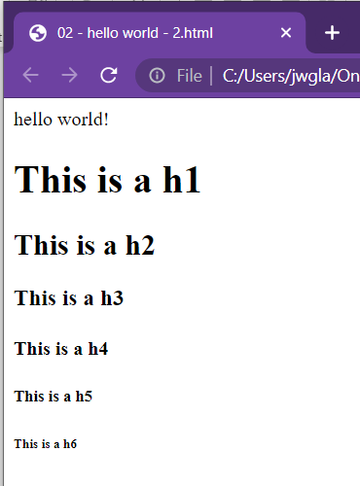
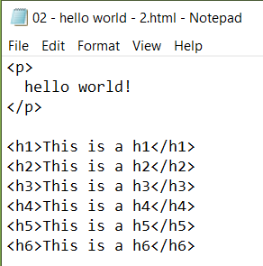
Heading tags

Slide 3
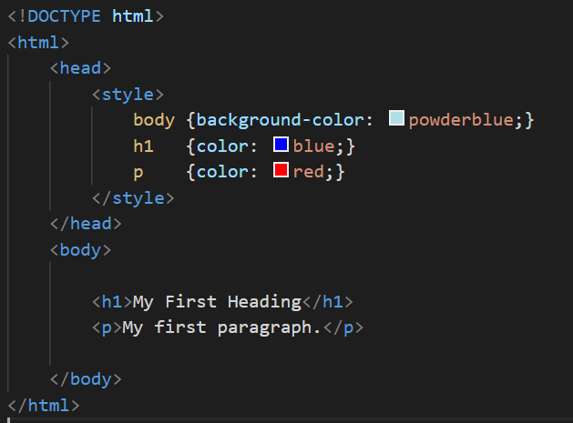
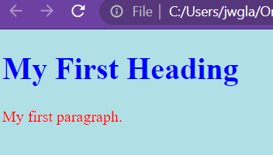

Slide 4

TAG attributes
Missing image

Slide 5

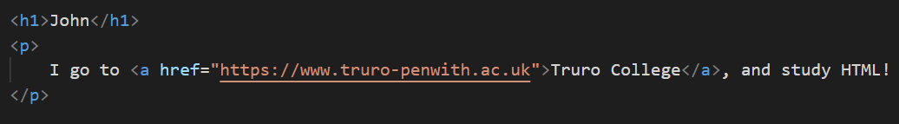
Anchor tags
How do you make the hyper in hypertext?
Linking documents together with links

Slide 6
Links
By default, links will appear as follows in all browsers:
An unvisited link is underlined and blue
A visited link is underlined and purple
An active link is underlined and red

Slide 7
task
Add an anchor link to your webpage

Slide 8
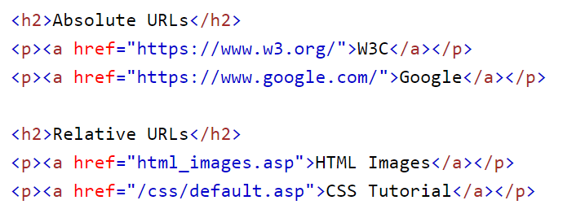

Slide 9
Task
Create a new git repo called “anchors”
Using the template you have created
Copy it THREE times into the folder “anchors”
index.html
contact.html
me.html

Slide 10
References and help
https://developer.mozilla.org/en-US/docs/Web/HTML/Element/a

